Slide 1
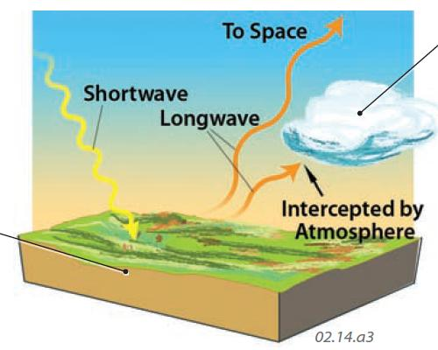
Recap: Simple Radiative Balance
ASR
OLR

Slide 2
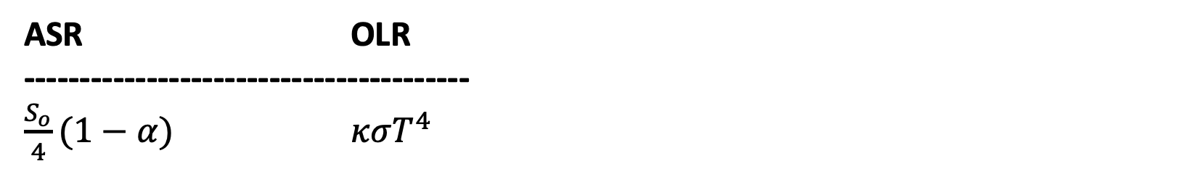
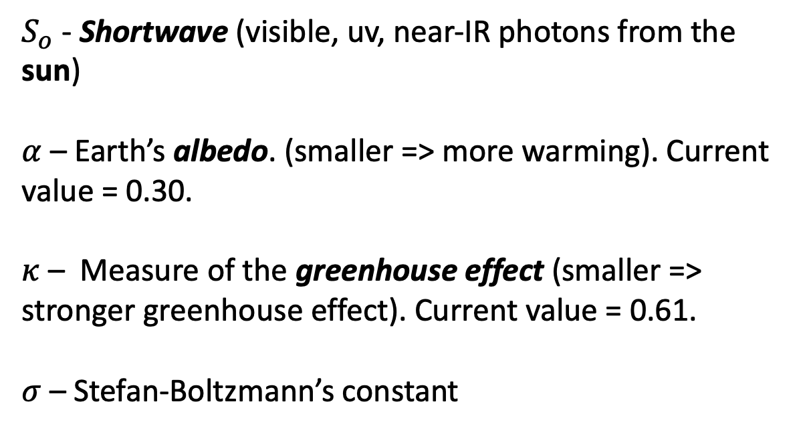
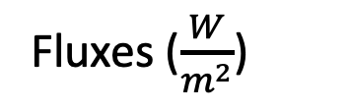
Recap: Simple Radiative Balance vocabulary: shortwave, longwave, $α$, $S_{o}$, 𝜅, 𝜎
ASR OLR
----------------------------------------
$\frac{S_{o}}{4}(1−α)$ $κσT^{4}$
$S_{o}$ - Shortwave (visible, uv, near-IR photons from the sun)
$α$ – Earth’s albedo. (smaller => more warming). Current value = 0.30.
$κ$ – Measure of the greenhouse effect (smaller => stronger greenhouse effect). Current value = 0.61.
$σ$ – Stefan-Boltzmann’s constant
Fluxes ($\frac{W}{m^{2}}$)

Slide 3

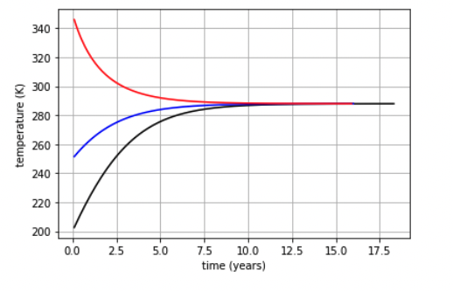
Recap: Simple Radiative Balance vocabulary: Homeostasis
Homeostasis
When ASR = OLR
Leads to the idea of a “Goldilocks Temperature”
Doesn’t depend the earth’s starting temperature.

Slide 4
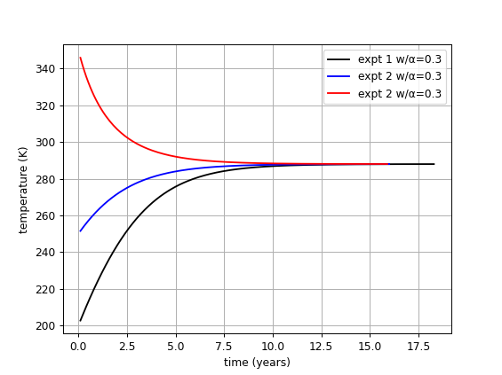
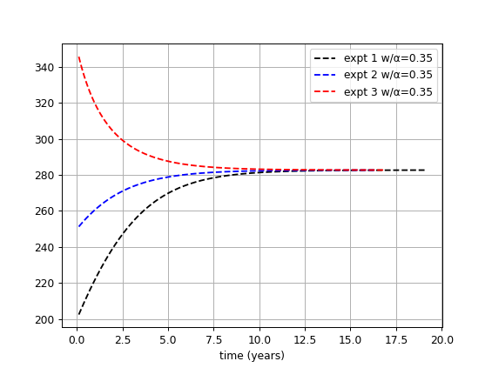
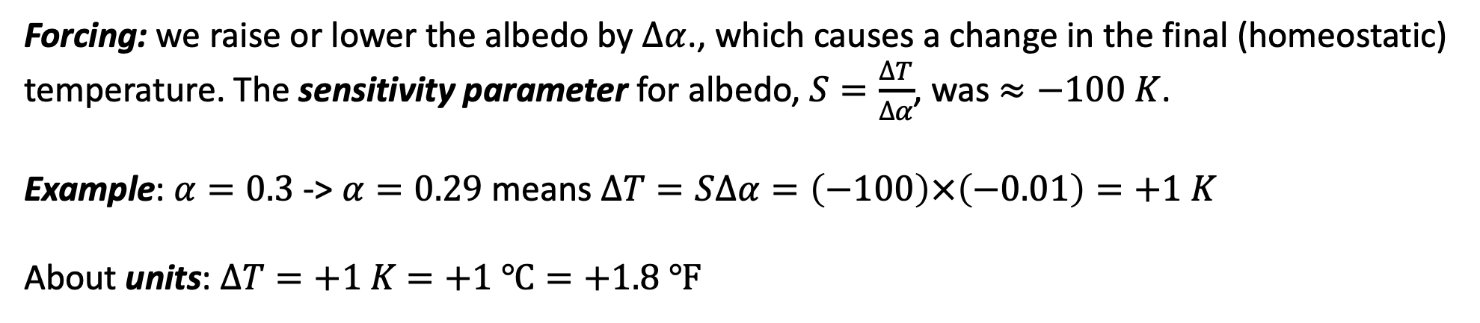
Recap: Climate sensitivity to forcings that result from changes in Earth’s albedo
Forcing: we raise or lower the albedo by $∆α$., which causes a change in the final (homeostatic) temperature. The sensitivity parameter for albedo, $S=\frac{∆T}{∆α}$, was $≈−100 K$.
Example: $α=0.3$ -> $α=0.29$ means $∆T=S∆α=\left(−100\right)×\left(−0.01\right)=+1 K$
About units: $∆T=+1 K$ $=+1 ℃=+1.8 ℉$

Slide 5
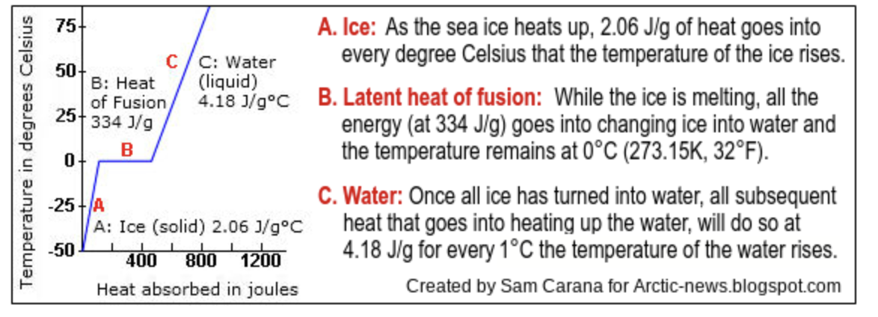
About the Discussion – The latent heat buffer in the Arctic

Slide 6
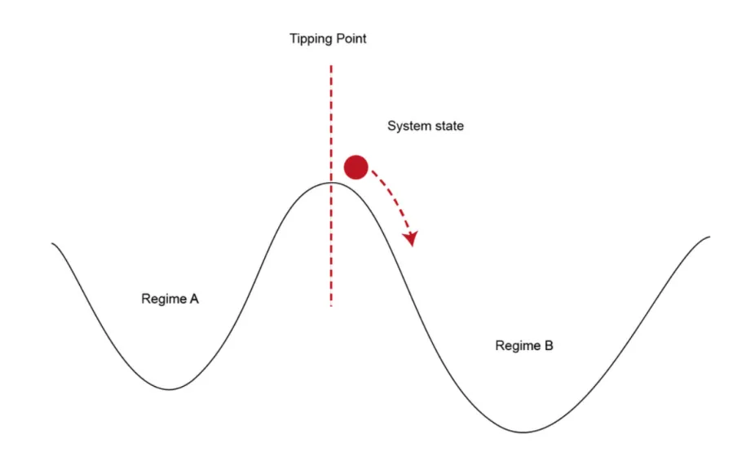
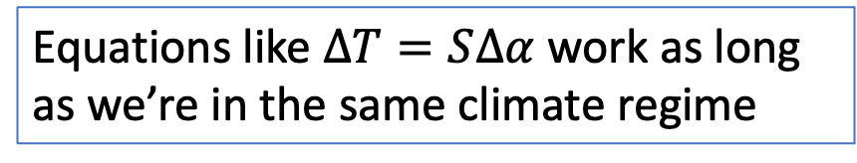
About the Discussion – What if a forcing leads to a homeostasis that lies in an entirely different climate regime?
But as we get close to a new climate regime, even tiny forcings can send us over
forcing
Equations like $∆T=S∆α$ work as long as we’re in the same climate regime
https://scied.ucar.edu/sites/default/files/styles/extra_large/public/images/tippingpoint_CC_rauter.png.webp?itok=jjVx9OvH

